Slide 1

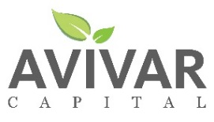
Georgia Social Impact Collaborative
Impact Investing 101
September 19, 2017
Prepared by:

Slide 2
AGENDA
Introduction to Impact Investing: The What
Rationale: The Why
Idea to Action: The How
Discussion
Appendix
Resources
Avivar Team

Slide 3
I. Impact Investing:
The What: Definitions & Trends

Slide 4

Impact Investing: A Social Investing Tool
SOCIAL INVESTING
SRI: SUSTAINABLE & RESPONSIBLE INVESTING
ESG: ENVIRONMENTAL, SOCIAL & GOVERNANCE CRITERIA
Screening
Shareholder
Activism
Impact
Investing
PRI/MRI
ACTIVE OWNERSHIP
PROACTIVE INVESTING
Notes:
Impact investments are part of a larger universe of social investing.
All of these approaches are aim to harness or leverage the power of capital markets and actors within those markets to drive positive social and/or environmental goals.
Some techniques will lend themselves better to the accomplishment of an individual investor's goals than others.
There are many terms for the practice know broadly as social investing, yet quite standard approaches. Term include:
ESG: Environmental, Social, Governance (factors in investment decisions)
Impact Investing
Local Investing, Community Investing
Mission Investing, Mission-Related Investing
Program-Related Investing
Responsible Investing
Social Investing, Social Impact Investing
SRI: Socially Responsible Investing
SRI: Sustainable and Responsible Investing
SRI: Sustainable, Responsible and Impact Investing (current definition, US SIF)
Sustainable Investing
Values Investing
Standard Approaches include:
Negative/Exclusionary: Exclusion from a portfolio of certain sectors or companies based on specific ESG criteria
Positive/Best-in-class/Inclusionary: Investment in sectors, companies or projects for positive ESG performance relative to industry peers
ESG Integration: Systematic and explicit inclusion of ESG risks and opportunities into traditional financial analysis
Sustainability themed investing: Selection of assets specifically related to sustainability in single- or multi-themed funds or portfolios
Proactive/Impact Investing: Investment aimed at solving social or environmental problems and/or unlocking opportunity
Shareholder Activism: Voting proxies and engaging management to influence corporate products and processes

Slide 5
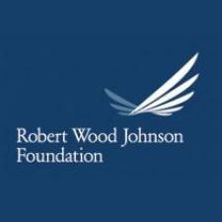







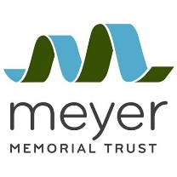



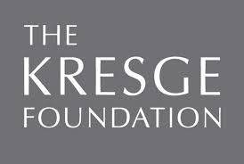
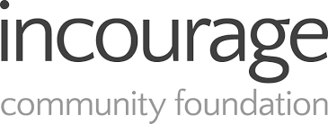
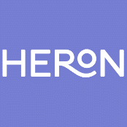

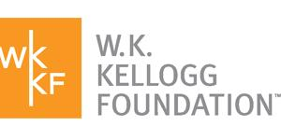

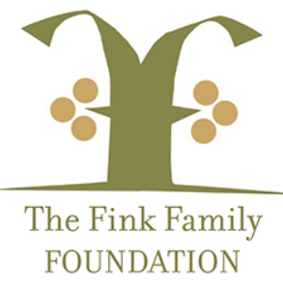


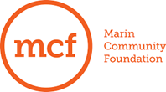
Range of Approaches – Many Practice More than One ¹
Negative/ Exclusionary Screening | Positive/ Best-in-class/ Inclusionary Screening | ESG Integration | Sustainability Themed Investing | Proactive/ Impact Investing | Shareholder Activism
²
Leadership is from foundations and others, and from US and global institutions.
Leadership opportunities exists for aligning larger shares of assets with mission.
¹ Adapted from US SIF, www.ussif.org.
² Source: http://divestinvest.org/philanthropy/signatories/
Notes:
Negative/exclusionary: the exclusion from a fund or plan of certain sectors or companies basedon specific ESG criteria
Positive/Best-in-class/inclusionary: Investment in sectors, companies or projects selected for positive ESG performance relative to industry peers
ESG integration: the systematic and explicit inclusion by investment managers of ESG risks and opportunities into traditional financial analysis
Sustainability themed investing: the selection of assets specifically related to sustainability in single- or multi-themed funds
Proactive/Impact investing: targeted investments aimed at solving social or environmental problems and/or unlocking opportunity

Slide 6
Impact Investing, SRI &ESG: A Wealth of Prudent Opportunity
Global Impact Investors Network/JPMorganChase 2017 Annual Survey tracked 209 respondents with some USD 114 billion in impact investing AUM, who:
Invested USD 22.1 billion into nearly 8,000 impact investments in 2016 and plan to increase capital invested by 17% to USD 25.9 billion in 2017.
Report that their investments have either met or exceeded their expectations for both impact (98%) and financial performance (91%).
Generally target risk-adjusted, market rates of return (2/3 of respondents), while noting the important role played by below-market-rate-seeking capital in the market.
Measure social and/or environmental performance using a mix of approaches, increasingly including the Sustainable Development Goals (SDG).
Believe that large-scale financial firms will professionalize the impact investing market and bring much-needed capital, but may cause mission drift or dilution.
Notes:
There has been tremendous growth in social investing—SRI, ESG and impact investing.
Morgan Stanley:
https://www.morganstanley.com/ideas/business-case-for-sustainable-investing
Mercer, 2014, THE EVOLUTION OF RESPONSIBLE INVESTMENT: “For most of our clients, responsible investment isn’t about changing the world; it’s about understanding how the world is changing and how companies will be affected. It’s about understanding where future growth will come from and having access to it. It’s about a company’s, an investment manager’s, or an investment committee’s role as a steward of capital to make sure all is being done to create efficient companies and capital markets — both prerequisites to delivering long-term retirement security to beneficiaries.”
GIIN Survey, 2017
In aggregate, 205 respondents invested USD 22.1 billion into nearly 8,000 impact investments in 2016 and plan to increase capital invested by 17% to USD 25.9 billion in 2017.
In total, 208 respondents currently manage USD 114 billion in impact investing assets. (One declined to provide this information.)
Nearly universally, respondents measure their social and/or environmental performance, using a mix of proprietary metrics, qualitative information, and IRIS-aligned metrics.
The overwhelming majority of respondents reported that their investments have either met or exceeded their expectations for both impact (98%) and financial performance (91%).
While two out of three respondents principally target risk-adjusted, market rates of return, there is widespread acknowledgement of the important role played by below-market-rate-seeking capital in the market.
The majority of respondents believe the entry of large-scale financial firms into impact investing will professionalize the market and bring in much-needed capital, but most also believe there is a risk of mission drift or impact dilution associated with this trend.

Slide 7
Impact Investing, SRI & ESG: Part of a Fast Growing Marketplace
  From 1995 to 2016, the SRI universe in the U.S. increased 14-fold to $8.72 trillion engaged in sustainable, responsible and impact investing, with a 33% increase since 2014.
33%
Notes:
The assets engaged in sustainable, responsible and impact investing practices at the start of 2014 represent nearly 18 percent of the $36.8 trillion in total assets under management tracked by Cerulli Associates. From 1995, when the US SIF Foundation first measured the size of the US sustainable and responsible investing market, to 2014, the SRI universe has increased tenfold, or 929 percent, a compound annual growth rate of 13.1 percent.
ESG INCORPORATION STRATEGIES AND TERMS
NEGATIVE/EXCLUSIONARY: the exclusion from a fund or plan of certain sectors or companies basedon specific ESG criteria
ESG INTEGRATION: the systematic and explicit inclusion by investment managers of ESG risks
and opportunities into traditional financial analysis
POSITIVE/BEST-IN-CLASS:* investment in sectors, companies or projects selected for
positive ESG performance relative to industry peers [*Also called Inclusionary]
IMPACT INVESTING: targeted investments, typically made in private markets, aimed absolving social or environmental problems
SUSTAINABILITY THEMED INVESTING: the selection of assets specifically related to
sustainability in single- or multi-themed funds
Source: US SIF Foundation
Per Aperio:
Exclusionary
- Worst Offenders
Entire Offending Sector
Inclusionary
Proactive Impact Investing

Slide 8
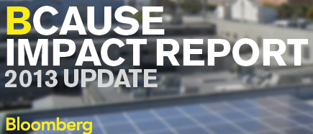

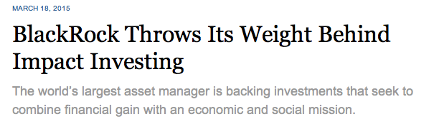
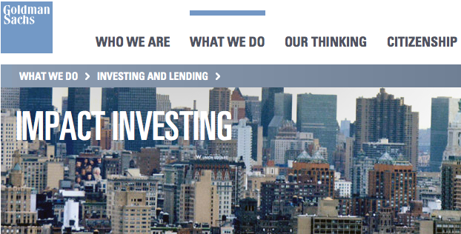
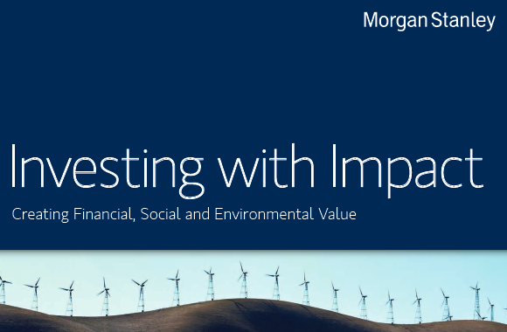
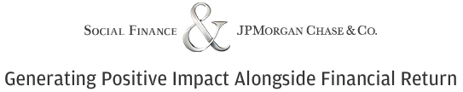


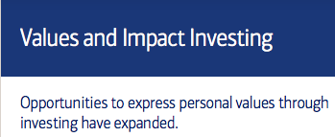
Impact Investing, SRI & ESG: Opportunity Recognized by the Mainstream
CONSCIENCE DRIVEN INVESTING

Slide 9
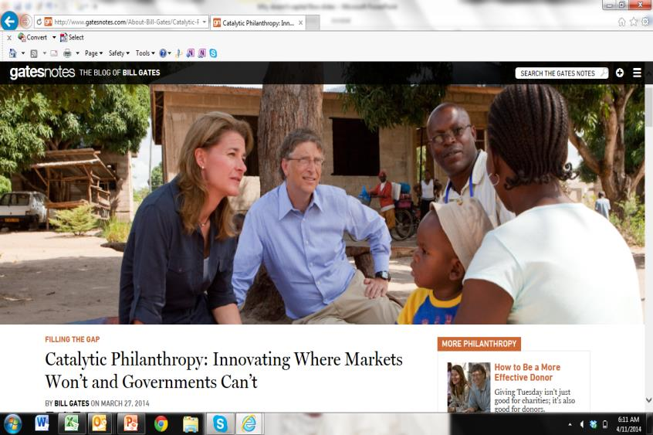
Impact Investing: A Philanthropic Tool¹
¹This slide adapted from the Kresge Foundation, www.kresge.org.

Slide 10
Impact Investing: A Philanthropic Tool
Investing into companies, organizations, and funds with the intention to generate measurable social and environmental impact alongside a financial return.¹
  Any asset class or structure
  Any tax structure of investee
  Any expected financial return
  Same fiduciary care as any institutional investment
BELOW MARKET-RATE INVESTMENTS²
Higher Risk Lower Risk
Cash
Fixed
Income
Public Equities
Alternatives
Grants & Recoverable
Grants
Alternatives
& Novel
Structures
Fixed
Income
Cash
Guarantees
Lower Risk Higher Risk
MARKET-RATE INVESTMENTS
Program-Related Investment / PRI Mission-Related Investment / MRI
¹Global Impact Investing Network, www.thegiin.org. ²Adapted from F..B. Heron Foundation
Notes:
Here we see that impact investing is investing proactively in companies, organizations or funds to generate measurable social and/or environmental benefits (impact) alongside a financial return.
Can be any asset class
Any expected financial return
Any tax structure of investee – ER required for private foundation PRIs into for-profit or other ER-triggering organizations
Below market-rate expected return often called program-related investments or PRI
Market-rate expected return often called (market-rate) mission-related investments or MRI
Again the theme of filtering: While it is possible to invest across the range of expected return profiles and asset classes, most impact investors begin with a more focused strategy that they build upon over time.

Slide 11
Impact Investing: The Feasibility
Impact
Thesis
Investment
Thesis
Impact
Investment
Build inclusive communities
Repayment?
- Revenue?
- Savings?
- Refinancing?
- Growth?
- Liquidity?
Notes:
For any impact investment:
Impact thesis = mission fit
Investment thesis = repayment / yield capacity

Slide 12
II. Rationale:
The Why

Slide 13
Impact Investing: The Need
Need
Barriers
Conventional markets allocate capital to “efficient,” profit-maximizing transactions:
Large, standard, fast/predictable
Investments in low-income and rural communities, communities of color, and innovative sectors seldom fit this “box”:
Smaller, high touch, unconventional, unfamiliar, less predictable
Systemic bias
Market lacks understanding of segment/product
Excess real or perceived risk
Limited market infrastructure or supportive “ecosystem”
High transaction costs
Policy barrier
Adapted from the Kresge Foundation, www.kresge.org.
Notes:
Why is impact investing needed and how can it help achieve an investor's goals?
Conventional markets allocate capital to “efficient” and profit-maximizing transactions
Typically, these can absorb and repay large amounts in standard structures over relatively short periods of time
Investment opportunities in low-income communities including communities of color and rural communities seldom fit this “box”
They tend to be small transactions that lack standard features and require “patient” timelines to develop repayment capacity without jeopardizing investee financial strength
Given the scale of capital needed to advance social equity in these areas, PRIs typically leverage the larger dollars of commercial capital markets.
PRIs typically finance the early, riskier stages of a project or strategy, and/or supply credit enhancement (loss protection) to absorb the real or perceived risk for needed conventional investors in larger transactions.
Potential Risks & Mitigation
Targeting PRIs to inexperienced organizations such as those often serving communities of color and rural communities raises the risk of investment loss.
PRIs are premised on credible repayment capacity, and MMT can invest through strong CDFIs with loan loss reserves and capacity building services that prepare organizations to qualify for and repay investments
PRIs can create unintended consequences, such as triggering predatory lenders or gentrification
Parallel community organizing and policy work are needed to advance social equity goals and prevent abuse
Driving a social equity goal can produce tension with a fully a responsive approach
MMT can help to educate all stakeholders on ways in which social equity goals can enhance their agendas
It is difficult to measure the success of social equity strategies due to multiple inputs and long time horizons
MMT’s dashboard can track proxies for social equity, as in Craft3’s dashboard (next slide). MMT can also encourage investees to prepare “stories with numbers” that convey the interplay of factors that drive change
Maintaining a social metrics dashboard is labor intensive
MMT can partner with an intermediary and/or universities for this function, potentially sharing costs with co-investors.

Slide 14
Impact Investing: The Opportunity
Impact investments are often seeded or complemented by grants. Given the scale of need to advance social equity in underserved communities, populations and sectors, impact investments often leverage larger conventional investors.
Grants
Impact Investments
Seed future investments (research, structuring)
Provide balance sheet equity
Support the non-financeable part of a transaction (e.g. street improvements alongside projects financed through the WCIF)
Operating costs
Policy/advocacy on threshold sector issues
Work with grants to finance the early, riskier stages of a project, enterprise or sector
Supply credit enhancement (loss protection) to absorb the real or perceived risk to attract conventional investors in larger transactions or pools
Adapted from the Kresge Foundation, www.kresge.org.
Notes:
Impact investments are not a sliver bullet. Often they work best in tandem with grants.

Slide 15
Impact Investing: The Opportunity
Align Resources
Need for impact capital far outstrips grant resources. Impact Investing increases resources while while altering capital markets to favor equitable, healthy and environmentally sustainable growth.
Expand Resources
Investors
Expand Impact
Capacity/ Leverage
Global Capital Markets
$212 Trillion
Investees
Managerial Discipline
US Budget
$3.8 Trillion
Sustainability & Scale
US Foundation Assets
$715 Billion³
Annual US Foundation Giving
$50 Billion
US Foundation Impact Investing
$10.6 Billion⁵
Source: McKinsey & Company. http://www.mckinsey.com/insights/global_capital_markets/mapping_global_capital_markets_2011
As of 2013. 3. Foundation Center 4. Nonprofit Philanthropic Trust 5. GIIN Morgan 2014MarketSpotlight
Notes:
The reasons for continued growth include but are not limited to:
Programmatic/mission benefits for investors (see slide)
Organizational benefits for investees (see slide)
An interest by an increasing group of investors in using impact investing to drive systems change in the capital markets.
While current impact investing levels are very small, impact investments can be structured to leverage government support and policy change, as well as the much larger amounts of capital the capital markets.
Thus impact investments are extremely useful to leverage the full range of government and capital markets resources we need to create equitable, healthy and sustainable communities for all.
Momentum is another benefit; can building upon learning from grants.

Slide 16
Impact Investing: Enhances 21st Century Philanthropic Toolkit
 | CONVENING | GRANTS | ADVOCACY | CAPACITY BUILDING | CAPITAL | EXAMPLE PORTFOLIO
PEOPLE
PLACE
PLANET

Slide 17

The Frontier:
Leveraging the Full Toolkit to Build Healthy Communities
Scale
Equitable, Sustainable and Vibrant Communities
Bank CRA + MRI + Others
Concessionary Investing PRI
Grants
& Subsidy
Supportive Ecosystem:
Anchors ∙ Value Chains ∙ Data ∙ Technology
Technical Assistance ∙ Innovation
Innovation:
Greater
Real or
Perceived Risk →
“Impact”
Leadership: Vision ∙ Policy ∙ Positive Messaging
Subsidy
Return

Slide 18
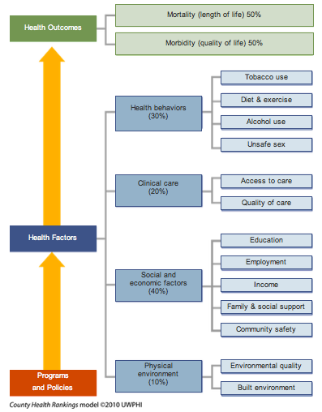

Frontier:
The County Health Rankings Model & Healthy People 2020 Agenda suggest investment opportunities for a
Healthy & Inclusive Region & Nation
Community Factors
~ 50-70%
Notes:
There are proven impact investing models that can reinforce each evidence-based health driver set out in the CHR model.
Many of these fit well to support place-based and/or social justice investor goals.

Slide 19
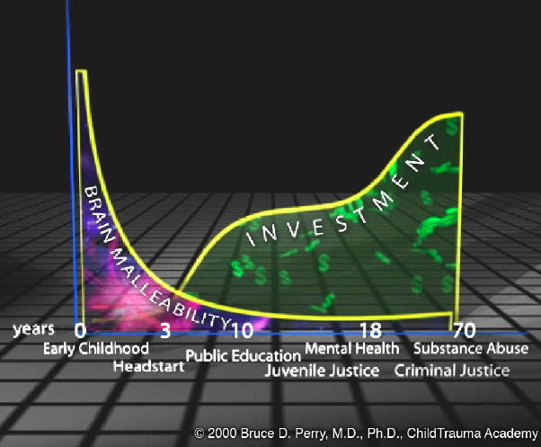
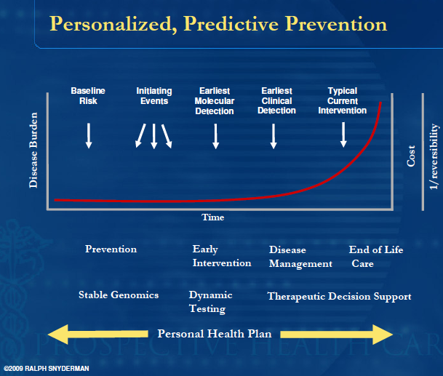
Frontier: Prevention v. Intervention
At the Nexus of People, Place, Planet, Sector & Time
Notes:
How do we invest grants, subsidy and capital for the highest impact within place?
Strategies that focus on people, place, (selected, evidence-based) sectors and time (life course, with an emphasis early in the life span and also for other high need/high cost phases). Planet refers to the environmental sustainability dimension that directly reinforces population health, as well as the natural resource base upon which all human and economic activity depends.

Slide 20

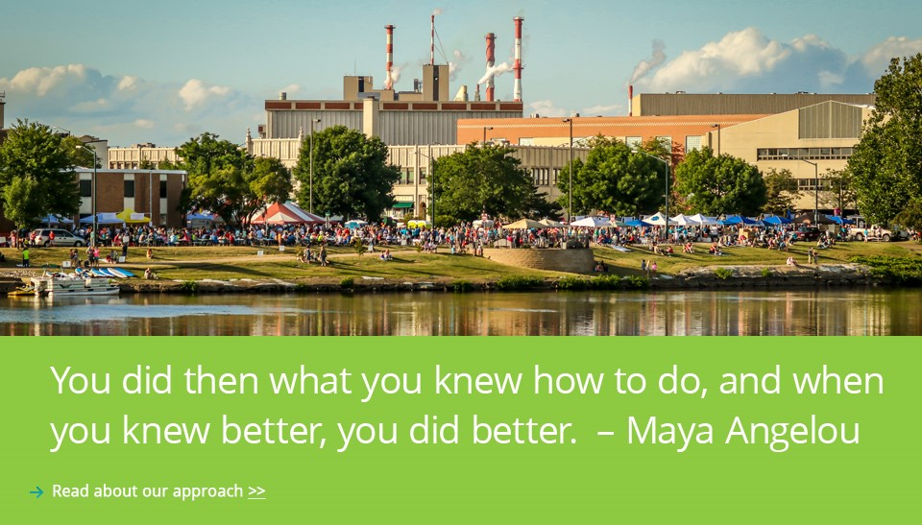
Community foundation serving Central Wisconsin and catalyzing statewide impact investing effort (early stage)
Seeks to realize a community that works well for all people, based upon equity, opportunity and shared stewardship
Committed 100% alignment of assets to mission
Avivar working with Incourage’s traditional investment advisor and specialists to apply:
  Mission criteria across foundation’s traditional asset allocation
  Shareholder activism strategy
100% for Mission
Investments in local banks & Community Development Financial Institutions (CDFIs)
Fixed-income supporting regional homeowners, infrastructure & small businesses
Wisconsin Passive Index Fund
Shareholder Activism
Notes:
Highlight: Example of an organization that was in a similar place to client
Notes on Incourage’s approach supported by partnership between Avivar & Colonial
They’ve never created their own impact investing unit but they believe that incorporating ESG criteria adds value
We had a client that wanted to put 100% of assets to mission
Neither had done this before
We took the lead role in facilitating the process
Prepared the IPS that was reviewed by advisor
Facilitated dialogues to help client articulate their social values that were then used as screens for conventional investments
Thought through with advisor what investments could be readily implemented
Traded equities
Creating a passive index of traded equities of companies headquartered in WI or heavily active there
Will have geographic screen and some other screens the client cares about
For those it finds objectionable, it will vote proxies and undertake shareholder activism
Both new of and agreed on firm that is experienced in setting up the passive indexes
Fixed Income & Alternatives
Both aware of fixed income managers
Expect that there will be a selection of WI based fixed income securities with a screen for sustainability and social justice
Alternatives
Conventional advisor knows of some funds headquartered in WI
Will likely generate a pipeline in each asset class and then work with client on selection

Slide 21


A national private foundation whose mission is to help people and communities help themselves out of poverty
Heron as an enterprise: removed the division between investing and giving operations, creating a “team of the whole” to deploy all of Heron’s capital for mission.
Look to find and deploy the best combination of financial, human, knowledge and social capital within and outside their walls on behalf of enterprises allied with the foundation.
Heron’s Investment Policy Statement notes:
“All enterprises, regardless of tax status, produce both social and financial results, on a spectrum from positive to negative, including 'neutral.' Their financial and social performance is measureable and varies over time. The conscientious investor takes note of both.”
Heron’s Investing Principles
Take an enterprise view
All investing is impact investing
Know what you own
Investing is an influence strategy
Notes:
Highlight: Blurring the distinction between grants and investments
1. A single team works as one to deploy all forms of capital
With only one investment thesis, and a market that includes all kinds of enterprises and asset types, it’s unreasonable to maintain two segregated staffs with separate missions, skill sets and world views. Heron eliminated the distinction, and now has one staff dedicated to deploying the foundation’s assets for mission. This includes not only our financial capital, deployed through a wide variety of vehicles, but also social capital such as time, relationships and knowledge.
2. Knowledge of what we own
As a philanthropic institution, we have a fiduciary duty to understand the impact of all our assets on society and to make decisions in light of that knowledge. While this impact can be hard to ascertain given current data availability, we have examined all of the enterprises in our portfolio to discover at a high level their performance, financial and social.
3. Measurement of performance across enterprises and asset classes over time
We have started tracking our financial and social performance across all legal forms of business (nonprofits, for-profits, cooperatives, partnerships, public companies, governments, and more) and benchmarking them against comparable organizations. Again, this effort is impeded by data availability, but we are actively investing in enterprises that will improve data transparency and standardization.
4. Collaborative, cooperative, outward-looking routines
We have a strong incentive to share underwriting and follow trusted partners into deals. Collaboration, syndication, and the use of funds and managers are not merely desirable for mission reasons but mandatory for financial reasons given our relatively small operation. We therefore are developing, with others, data infrastructure, comparable performance analyses, certification protocols, investment vehicles, standard documentation, cross-mission financial vehicles, and the like, to stimulate and enable co-investment and reduce transaction costs.

Slide 22


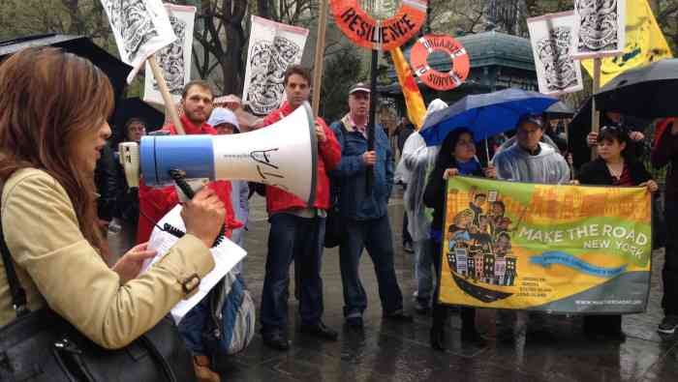
A national private foundation that supports U.S. grassroots organizations and movements to change environmental, social, economic and political conditions for a more just, equitable and sustainable world.
In the early 1990’s, the Foundation decided to harmonize their investments with their mission as a social justice grantmaker.
The Foundation’s Investment Policy Statement states:
"we believe that efforts to mitigate environmental degradation, address issues of social justice and promote healthy communities should be incorporated as part of business and investment decision making […] foundations have a particular role to play […] seeing their mission not only in terms of the uses of income to fund programs, but also in terms of the ends toward which endowment assets are managed."
Strategies Employed
Screening
(Exclusionary & Inclusionary)
Active Ownership
Proxy Voting
Shareholder Engagement

Slide 23

Family foundation established in 1959 to preserve the lifelong altruistic commitment of its founders, Richard Prentice Ettinger and his wife, Elsie P. Ettinger.
EFA focuses on three distinct program areas: Arts, Environment, and Reproductive Health and Justice.
Active in impact investing since 1990’s and one of the original signatories to Divest-Invest movement.
Impact Investing Strategies
Shareholder Engagement
Shareholder resolutions and activism – e.g. Home Depot phased out old growth forest products
Portfolio Screening
Fully diversified portfolio actively screened for ESG factors
Divesting & Investing
Divested from fossil fuels and investing in climate solutions to accelerate the transition to a clean energy economy

Slide 24
III. Idea to Action:
The How

Slide 25
Avivar’s Impact Investment Life Cycle Frames Process
Planning
Goals & Metrics
Policy
Scope & Purpose
Process & Procedures
Manager / Financial Intermediary Selection
Portfolio Management
Portfolio Execution
Landscape Analysis
Organizational Design
Evaluation & Learning
Governance
Risk & Return Objectives
Risk Management
Transaction Execution
Monitoring & Reporting
Program Integration
Staff / Consultant Roles
Communications
Leverage - Donor & Partner Engagement
Notes:
Notes
No one investor enters in the same place and/or follows an identical path

Slide 26








Planning: Targeting for Impact
Place-Based
(Rhode Island)
Sector-Based
EDUCATION
HEALTH
ECONOMIC SECURITY

Slide 27
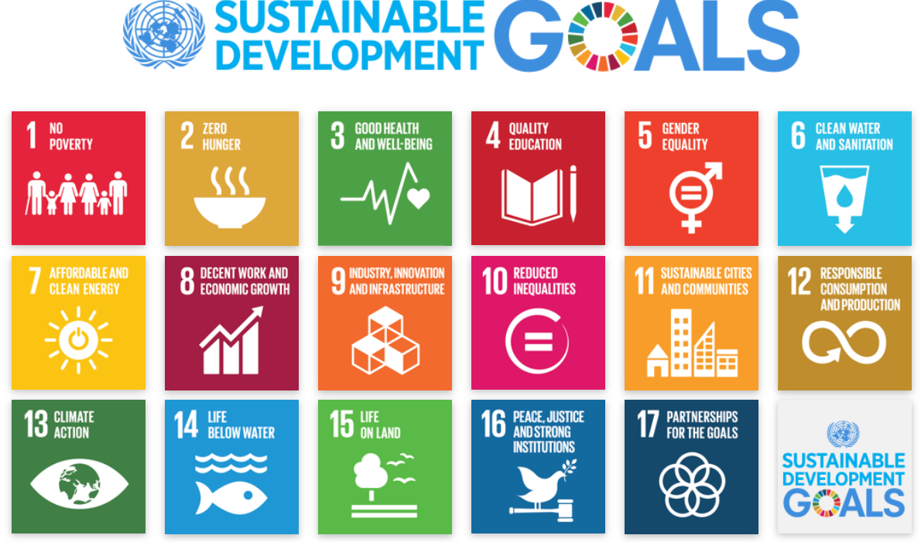
Example: UNDP Sustainable Development Goals
Increasingly Driving Impact Investing Strategies
Source: http://www.undp.org/content/undp/en/home/sustainable-development-goals.html
Notes:
http://www.undp.org/content/undp/en/home/sustainable-development-goals.html
The UNDP Sustainable Development Goals (SDGs), otherwise known as the Global Goals, are a universal call to action to end poverty, protect the planet and ensure that all people enjoy peace and prosperity.

Slide 28
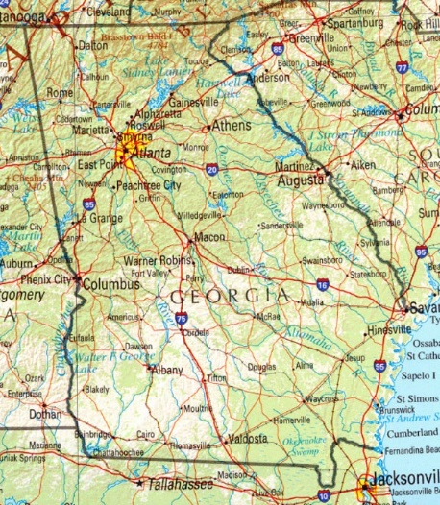
Planning: Landscape Scan within Place by Market Sector
Investible Nonprofit /
Enterprise Sectors
Investor / Funder /
Donor Partners
CDFIs
Community Banks
Housing Developers
Health, Education, Human Service Providers
Social Enterprises/Small Businesses
To discuss
Research Partners
Technical Assistance Partners
To discuss
Government
Partners
To discuss
To discuss

Slide 29
Planning: Coordinating Capital
for Equitable, Healthy Communities Across Asset Classes
Goals
Increase access to healthy human development, vital communities, environmental sustainability
Complement grants; leverage conventional capital to finance healthy & vibrant communities
Socio-Economic Factors
Childhood / Youth Development Fund
Healthy Ag
& Food Systems Fund
Microfinance
Asset Building Financial Services Fund
Family of Funds:
Equitable, Healthy Communities
with Impact Investing
Small Business Lending
Affordable & Supportive Housing Fund
Community Health Provider Fund
Infrastructure & Transit-Oriented Development Fund
Opportunistic Fund
Built Environment
Open Spaces
Access to & Quality of Care
Notes:
We can further optimize impact by coordinating not only grants and investments, but also investments across sectors or themes.
Here we set out a “family of funds” grounded in the evidence-based health factors from the County Health Rankings—Built Environment, Socio-Economic Factors and Access to and Quality of Care.

Slide 30
Planning: Coordinating Capital
for Equitable, Healthy Communities Across Asset Classes
 | Grants | Guarantee | Cash | Debt | Fixed Income | Public Equity | Private Equity | Venture Capital
People
Place
Planet
Notes:
Need to articulate the investment thesis for each of these
What are we trying to achieve from an impact perspective
What kind of capital is needed and how much
Who are the target investees
Who are the target investors and what is their risk/return profile
How does the vehicle/instrument need to be structured to build a bridge between those two
Existing CDFI/Fund Manager already doing this work on balance sheet or through existing fund?
Existing CDFI /Fund Manager that could create a new initiative/fund?

Slide 31
Mapping Mission & Values to Investment Policy
I. PURPOSE & SCOPE
Mission/Vision: | Advance equality in the region.
II. DEFINITION OF DUTIES
Board: II Cmtee: Staff: Managers: Consultants: Custodian: | [TBD]¹
III. OBJECTIVES & CONSTRAINTS
Objectives: | Drive Foundation’s strategic priorities while earning a rate of return that allows meeting liquidity requirements, covering the cost of operations and keeping keep pace with inflation. [Specifics TBD].
Constraints: | The following types of investments are prohibited: [TBD].
IV. CRITERIA & GUIDELINES
Amount: | Fixed $ or % commitment (0 – 100%)
Geography: | [TBD]
Sector: | [TBD]
Asset Class²: | [TBD]
Investment Size: | [TBD]
Expected Return: | Concessionary and/or market-rate risk-adjusted financial return.
Manager Selection: | Prioritize manager diversity.
Direct Inv. Selection: | [TBD]
V. MONITORING & REPORTING
Key Risks: Compliance: Financial: Social: | Key risks mitigated and tracked Adherence to payment terms, covenants Performance relative to plan, benchmarks, trends Performance relative to specified metrics
¹ A draft Impact Investing Policy Statement contains guiding questions for discussion related to addressing the above [TBDs].
² The IIPS can include appendices with policies for individual asset classes and other matters, as needed.

Slide 32


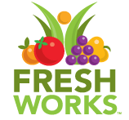

Sourcing Impact Investments
Guided by an Investment Policy Statement, impact investors seek investment opportunities with a strong impact thesis and investment thesis, while matching the asset class and/or structure to the opportunity.
 | Community Clinic | Med Tech Growth Firm | Healthy Food Access | Supportive Housing
Mission: Impact Thesis Risk/Return: Investment Thesis | Increases access to care Repays via reimbursement revenue | Improves quality & affordability of care Repays via earnings growth and liquidity event (exit) | Increases access to healthy food & drives economic development Repays via earnings growth | Reduce hospital care & incarceration via supportive services Housing subsidies and rent provide cash flow for debt service
Geography Sector/Program Asset Class Intermediary/Direct | California Healthy People: Clinics Debt: Fits clinic nonprofit status Intermediary: Provides sector expertise | California Healthy People: Tech Equity: Fits for-profit growth firm Direct: Targets support for firm and impact | California Healthy People: Food Debt: Fits for privately owned small businesses Intermediary: Fund manager has expertise | California Healthy People: Housing Debt: Fits for rental property development Intermediary: Provides sector expertise
Company/ Organization/ Fund/Manager Selection Criteria | Intermediary with strong track record deploying investor capital in California community health clinics | Performance & growth prospects in addressing unmet need for dermatology specialists in community-based primary care settings | A CDFI with strong track record lending to food retail establishments in California | Intermediary with strong track record developing and managing supportive housing units
Investment | West Coast HQ: Oakland | HQ: Modesto, CA | Fund Manager: CIP | HQ: New York

Slide 33
Operations – Process & Procedures
Portfolio Allocation/ Investment Thesis
Sourcing
Initial Review/ Triage
Full Due Diligence
Investment Process
Funding
Closing
Approval
Structuring
Payments & Reporting Tracked
Financial Statement Analysis
Covenant Compliance Calculated
Credit Report Drafted
Monitoring Questions Emailed
Debt
Site Visits
Quarterly Monitoring Report
Dashboard Updated
Credit Report Finalized
Quarterly Call
Tracking, Reporting & Monitoring
Track Investee Quarterly Reports
Monitoring Questions Emailed
Board Observer in Quarterly Meetings/Calls
Dashboard Updated
Quarterly Monitoring Report
VC

Slide 34
Plan
Pol
Proc
Prog
Models for Co-Investing – Increase Impact, Lower Cost & Risk
Function | Shared Services Platform | Regional Fund or Fund of Funds (FOF)
Planning Education, Goals & Metrics Landscape Analysis Leverage - Donor & Partner Engagement Organizational Design | Cafeteria-style menu of services available to support members/ clients—discrete to fully outsourced | Fund or FOF develops strategy and metrics; often per investor/ stakeholder board priorities
Policy Scope & Purpose Governance Risk & Return Objectives Risk Management | Customized policy for individual institution or specialized cohort | Board-led Fund or FOF policy including risk appetite; often investor driven
Process Manager / Financial Intermediary Selection Staff / Consultant Roles Transaction Execution Monitoring & Reporting | Customized support for transaction execution and monitoring; potential for lowered cost and risk on co-investments | Fund or FOF invests on behalf of investors, sourcing and executing deals per strategy and policy
Program Management Program Execution Program Integration Evaluation & Learning Communications | Customized support for impact tracking and reporting, continuous learning and improvement | Fund or FOF manages all activities, reporting to board, investors and stakeholders; Investors can co-invest

Slide 35
IV. Appendices

Slide 36
Resources
Reports and Articles
Dietel, William, past Chairman, F.B. Heron Foundation, Mission Stewardship: Aligning Programs, Investments, and Administration to Achieve Impact,
http://heron.org/sites/default/files/fb_heron_foundation_Mission_Stewardship_Aligning_Programs.pdf
Morningstar, The Morningstar Sustainable Investing Handbook, http://corporate1.morningstar.com/Morningstar-Sustainable-Investing-Handbook-2/
The Forum for Sustainable and Responsible Investment (US SIF), US Sustainable, Responsible and Impact Investing Trends 2016, http://www.ussif.org/files/SIF_Trends_16_Executive_Summary(1).pdf
Interfaith Center on Corporate Responsibility, Our Vision for Responsible Investing, 2016, http://www.iccr.org/sites/default/files/2016_iccr_ar_final_0.pdf
UNEP Finance Initiative, Fiduciary Responsibility in the 21st Century, http://www.unepfi.org/publications/investment-publications/fiduciary-duty-in-the-21st-century/
Global Impact Investing Network, 2017 GIIN Annual Impact Investor Survey
https://thegiin.org/knowledge/publication/annualsurvey2017
Lee, Linda-Eling and Moscardi, Matt, Global Head of ESG Research and Head of Financial Sector Research for MSCI ESG Research, respectively, 2017 ESG Trends to Watch, January 2017, https://www.msci.com/documents/10199/cbc27309-8157-4589-9cc0-00734bca6a6b
Global Impact Investing Network and Cambridge Associates, Introducing the Impact Investing Benchmark (refers to the financial performance of market rate private equity and venture capital impact investing funds), https://thegiin.org/assets/documents/pub/Introducing_the_Impact_Investing_Benchmark.pdf
Mission-Aligned Investment Policy Statements and Strategies
F.B. Heron Foundation | http://heron.org/engage/publications/investment-policy-statement
Jesse Smith Noyes Foundation | http://www.noyes.org/impact-investing/investment-policy
Investments at the Vermont Community Foundation | http://www.vermontcf.org/Portals/0/Uploads/Documents/Investment_Brochure_Mar2015.pdf
KL Felicitas Foundation | http://klfelicitasfoundation.org/impact-investing-overview/strategy-overview/
National & Global Impact Investing Associations / Initiatives
Case Foundation Network Map, https://casefoundation.org/networkmap/?nabe=6116754236899328:0
Confluence Philanthropy, http://www.confluencephilanthropy.org/
Global Impact Investing Network, https://thegiin.org/
Mission Investors Exchange, http://missioninvestors.org/

Slide 37
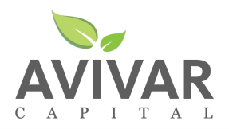
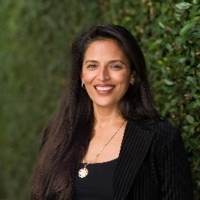

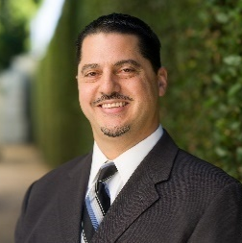
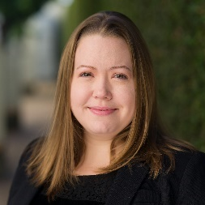
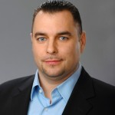

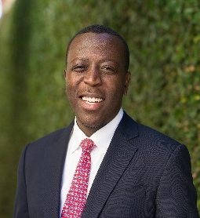


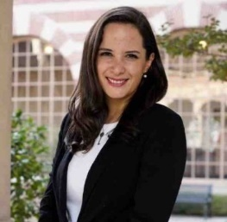

Avivar Capital (Avivar) is a U.S.-based SEC registered investment advisor focused on impact investing. Avivar assists foundations, banks, health systems, other institutional investors and families to design and execute impact investing strategy for financial, social and environmental return. The firm’s professionals bring domestic and international experience to serve as investment strategists, deal and fund structurers, asset managers, due diligence providers, coaches, trainers, market researchers, facilitators, and evaluators.
Tina N. Castro, CFA
Managing Partner
Lisa Richter
Managing Partner
Daniel Tellalian
Managing Partner
Theresa Wilson
Director of Operations
Ariel Jaduszliwer
Senior Advisor
Matt Rho
Senior Advisor
Brian Wasige
Advisor
Yu Gu
Summer Associate
Christine Onyung
Summer Associate
Alejandra Revueltas
Summer Associate
Anita Foster
Special Projects

